Slide 1
Advanced Javascript
Day 7 - API, fetch I

Slide 2
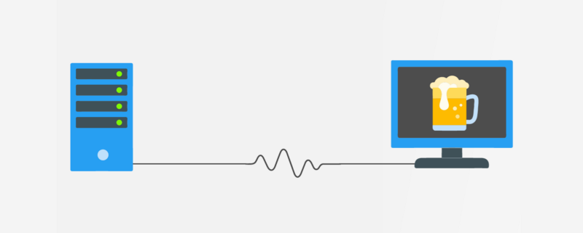
API

Slide 3
Application Programming Interfaces (APIs) are constructs made available in programming languages to allow developers to create complex functionality more easily.
They abstract more complex code away from you, providing some easier syntax to use in its place.

Slide 4
Types of API

Slide 5
Browser APIs — constructs built into the browser that sits on top of the JavaScript language and allows you to implement functionality more easily.
Third-party APIs — constructs built into third-party platforms (e.g. Twitter, Facebook) that allow you to use some of those platform's functionality in your own web pages (for example, display your latest Tweets on your web page).
JavaScript libraries — Usually one or more JavaScript files containing custom functions that you can attach to your web page to speed up or enable writing common functionality. Examples include jQuery, Mootools and React.
JavaScript frameworks — The next step up from libraries, JavaScript frameworks (e.g. Angular and Ember) tend to be packages of HTML, CSS, JavaScript, and other technologies that you install and then use to write an entire web application from scratch. The key difference between a library and a framework is “Inversion of Control”. When calling a method from a library, the developer is in control. With a framework, the control is inverted: the framework calls the developer's code.

Slide 6
Let’s quickly recap HTTP and Client Server Model...

Slide 7
JavaScript can send network requests to the server and load new information whenever it’s needed.

Slide 8
We have already talked about HTTP requests like GET, POST, PUT, DELETE.
Right now our websites are simple and doesn’t have dynamic data.

Slide 9
For example, we can use a network request to:
Submit an order,
Load user information,
Receive latest updates from the server,
…etc.
There’s an umbrella term “AJAX” (abbreviated Asynchronous JavaScript And XML) for network requests from JavaScript.

Slide 10
There are multiple ways to send a network request and get information from the server.

Slide 11
fetch

Slide 12
The Fetch API, has been standardized as a modern approach to asynchronous network requests

Slide 13
Why Fetch?
Clean and easy syntax.
Modern way of making network requests.

Slide 14
3 Steps of Fetch
fetch(url)

Slide 15
3 Steps of fetch
.then(function() {
//What do you want to do if you get back response
})

Slide 16
3 Steps of fetch
catch(function() {
//What do you want to do if there’s an error
});

Slide 17
To summarize, using the Fetch API will look like this:
fetch(url)
.then(function() {
})
.catch(function() {
});

